Slide 1
CUISINE CLASSIFICATION
Center for Computational Biology
IIIT-D

Slide 2
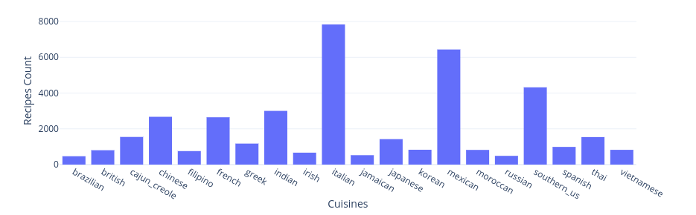
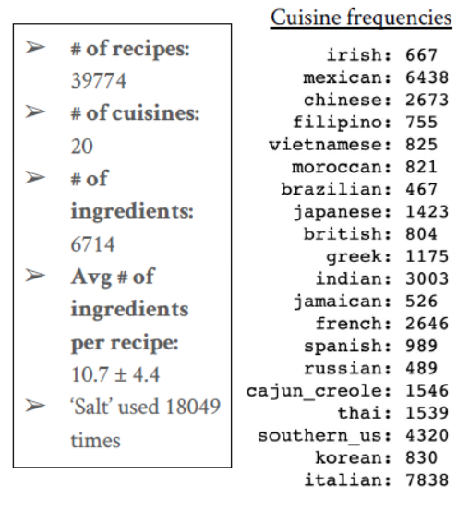
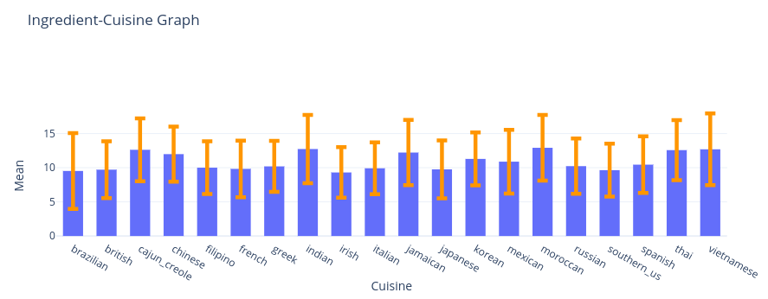
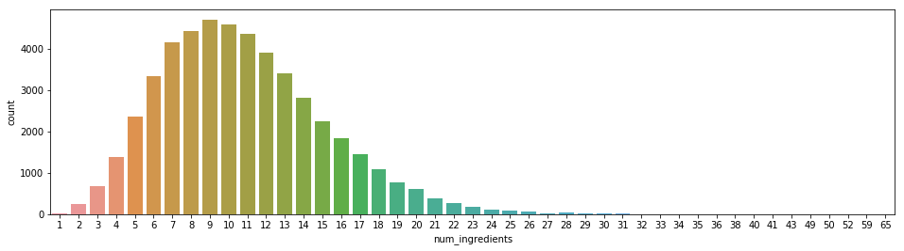
Know The Data

Slide 3
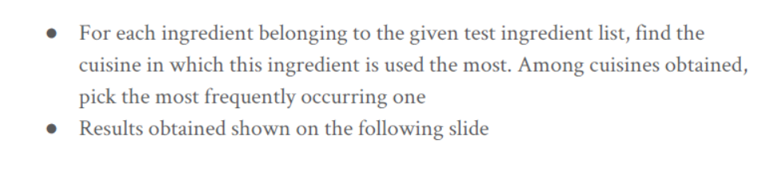
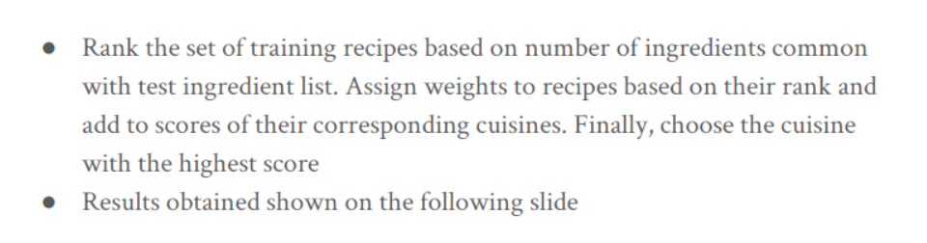
Seminal Work
Frequency Based Model
Recipe Matching Model

Slide 4
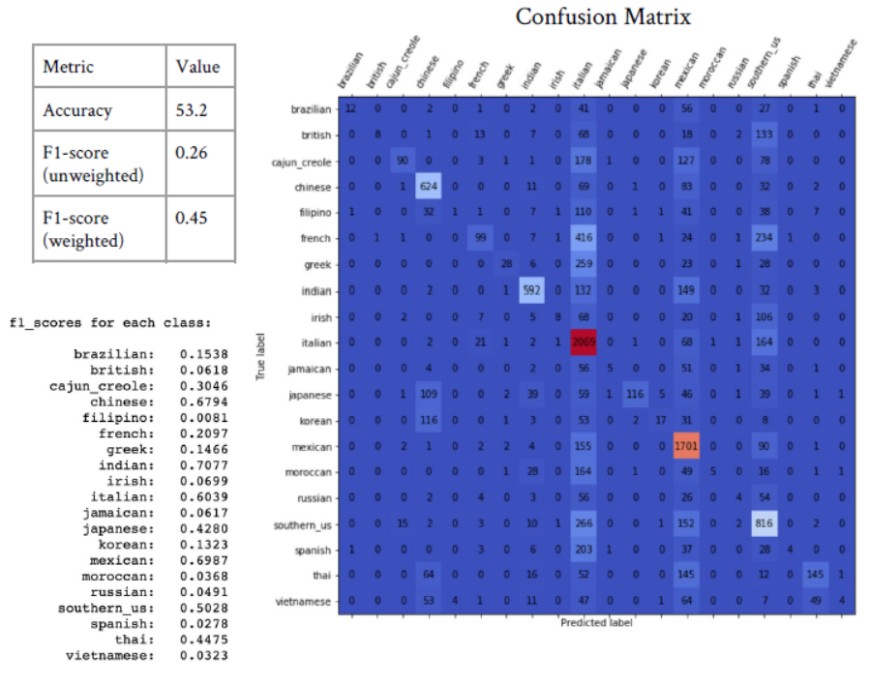

Frequency Based Model
Recipe Ranking Model

Slide 5
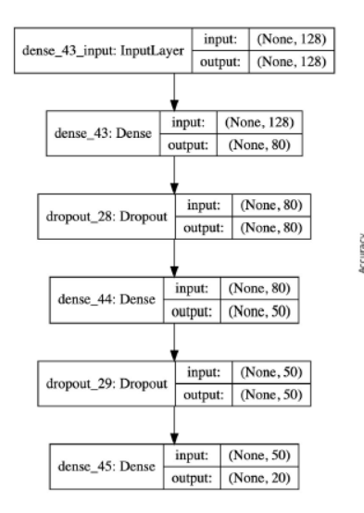
Best Result (previous work)
NN with One-hot Encoding

Slide 6
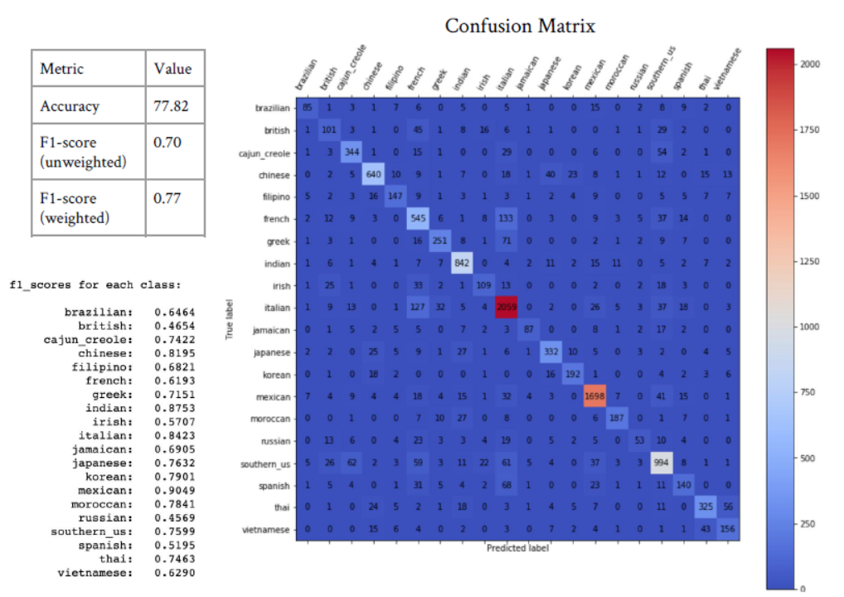

Slide 7
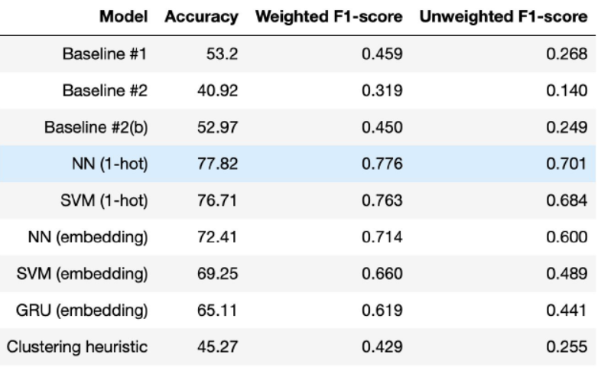
Summary of Previous Work

Slide 8
Current Work Objectives
Achieve Good Accuracy
Achieve Accuracy mentioned Kaggle
Visualize
Infer

Slide 9
Pipeline
Data Preprocessing
TFIDF vs CountVectorizer
Models
Logistic Regression
SVM + Multiclass Classifier
Kernel – {‘rbf’ , ‘linear’}
NN
RandomForest

Slide 10
Data Pre-processing
Remove outliers such as single-ingredient recipes
water => Japanese
butter => Indian
butter => French
Convert to lowercase
Remove hyphen
Remove numbers
Remove words which consist of less than 2 characters
Lemmatize
Examples:
('Eggs‘ -> 'egg'),
('all-purpose flour‘ -> 'all purpose flour'),
('purée‘ -> 'purée'),
('1% low-fat milk‘ -> 'low fat milk'),
('half & half‘ -> 'half half'),
('safetida (powder)‘ -> 'safetida (powder)')

Slide 11
Accuracy Overview
Model with TFIDF | Accuracy
Logreg | 78.6
SVM (kernel=linear) | 78.2
SVM (kernel=rbf) | 81.2
Random Forest | 74.4
NN | 75.8

Slide 12
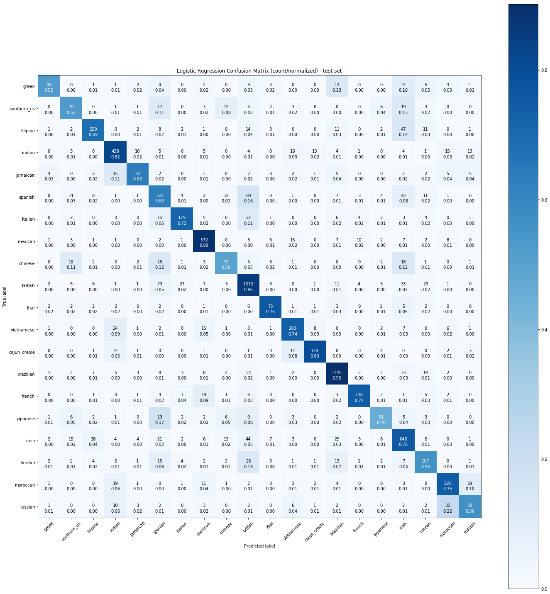
Logistic Regression

Slide 13
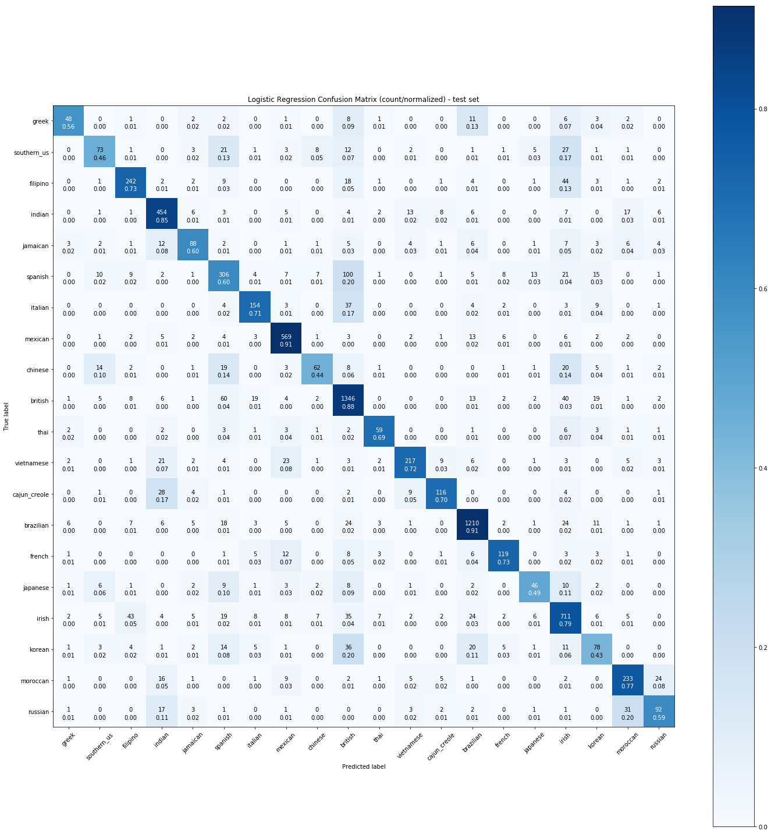
Linear SVM

Slide 14
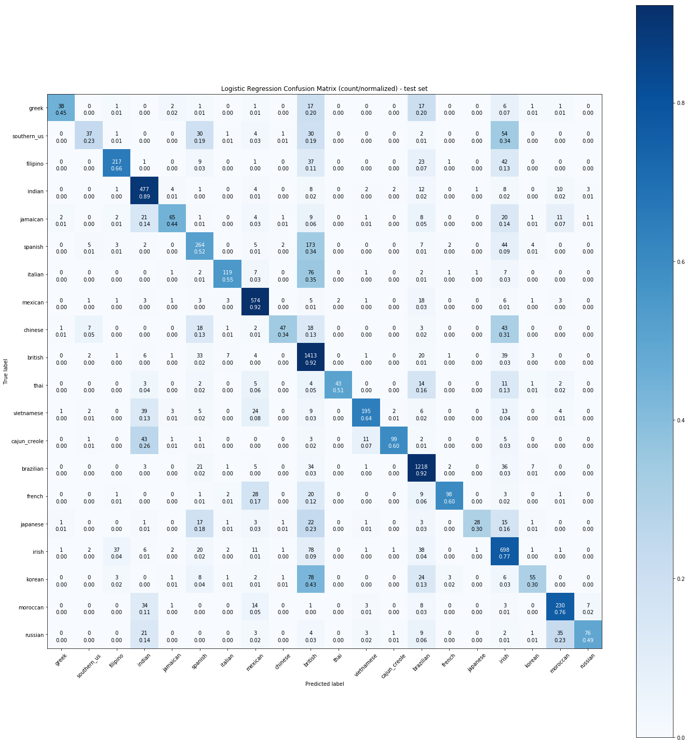
Random Forest

Slide 15
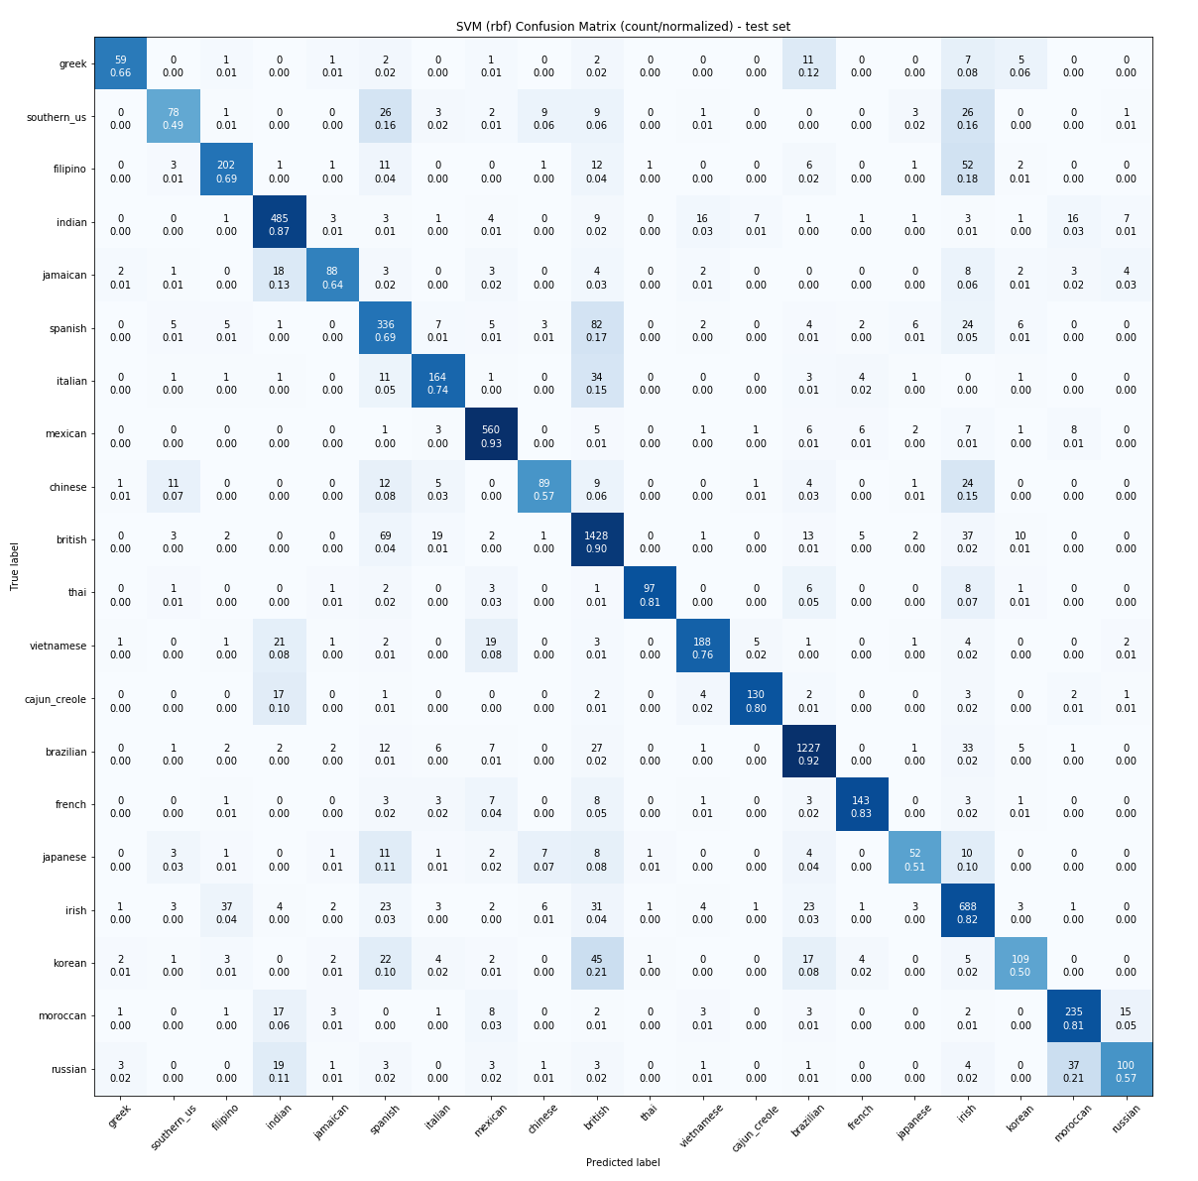
SVM kernel=‘rbf’

